Slide 1

Spatial-temporal Transformer Network with Self-supervised Learning for Traffic
Flow Prediction
Zhangzhi Peng, Xiaohui Huang
East China Jiaotong university
Notes:
Hello everybody. 大家好。It is a Chinese dialect saying hello.
I am Zhangzhi Peng, I will present our work titled Spatial-temporal Transformer Network with Self-supervised Learning for Traffic
Flow Prediction.

Slide 2
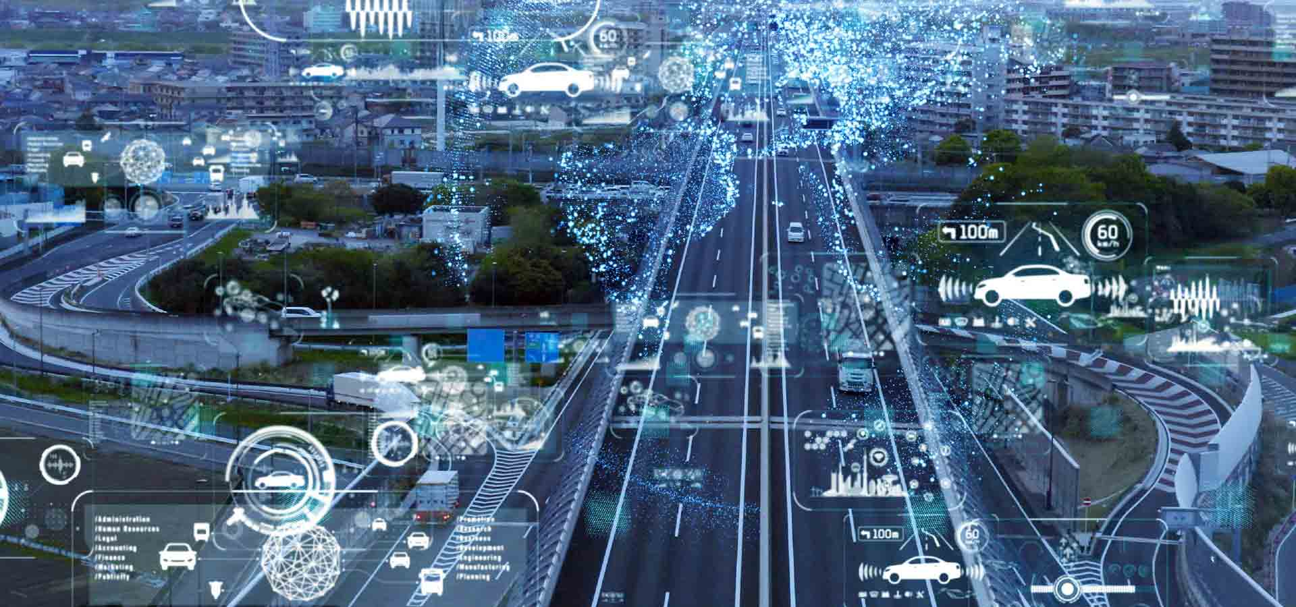
Intelligent Transportation Systems (ITS)
Traffic flow prediction is a build-block task in Intelligent Transportation Systems (ITS),
Notes:
With massive amount of sensor deployed,
large scale traffic data is collected to build Intelligent Transportation Systems (ITS).
traffic flow prediction is a build block in Intelligent Transportation Systems (ITS), which is essential for providing efficient, secure, and high-quality traffic service

Slide 3
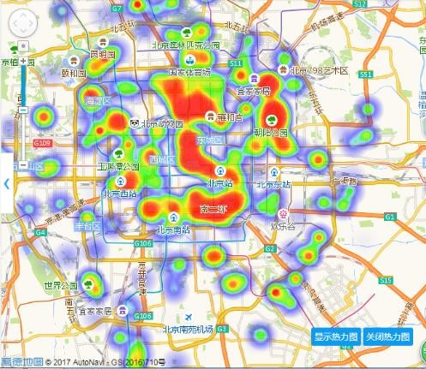
Traffic flow Data
Flow map of the city Beijing
4

Slide 4
Traffic flow Data
    Divide a geographic area into raster areas that are equally spaced in length and width
4
Notes:
We partition a city into an image-like grid map according the longitude and latitude,

Slide 5

Traffic flow Data
2D matrix
    Divide a geographic area into raster areas that are equally spaced in length and width.
4
Notes:
It is a 2D matrix

Slide 6
Crowd flows in a region
periodically record the number of people arriving at and departing from a location
Notes:
The value of a grid denotes the traffic flow (inflow or outflow). The device deployed at a region will periodically record the number of people arriving at and departing from the location to collect the inflow and outflow.

Slide 7
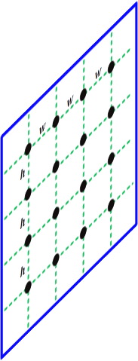
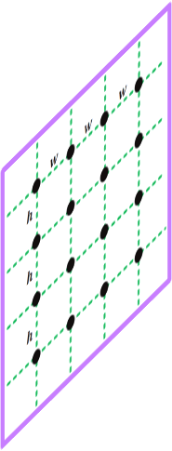

Problem Formation
Given historical records, traffic flow prediction aims to predict the traffic flow in the future.
t
Notes:
This problem can be considered from the spatial and temporal perspectives.

Slide 8
Problem Formation
Spatial dependencies. Traffic volume is influenced by its neighbors.
Short-range spatial correlations
t
Notes:
From the spatial perspective, The traffic flow in a region is influenced by its nearby regions.

Slide 9
Problem Formation
Spatial correlations. Traffic volume is influenced by its neighbors.
Two distant regions show spatial correlations.
e.g., transportation hub.
t

Slide 10
Problem Formation
Temporal dependencies. The flow of a region is affected by recent time intervals, both near and far.
t
Notes:
The flow of a region is affected by recent time intervals. For example, the morning rush hour starts from 8AM and may last till 10 AM. And the rush hour happens every workday.
The temporal properties can be considered in two parts. The first is closeness.

Slide 11
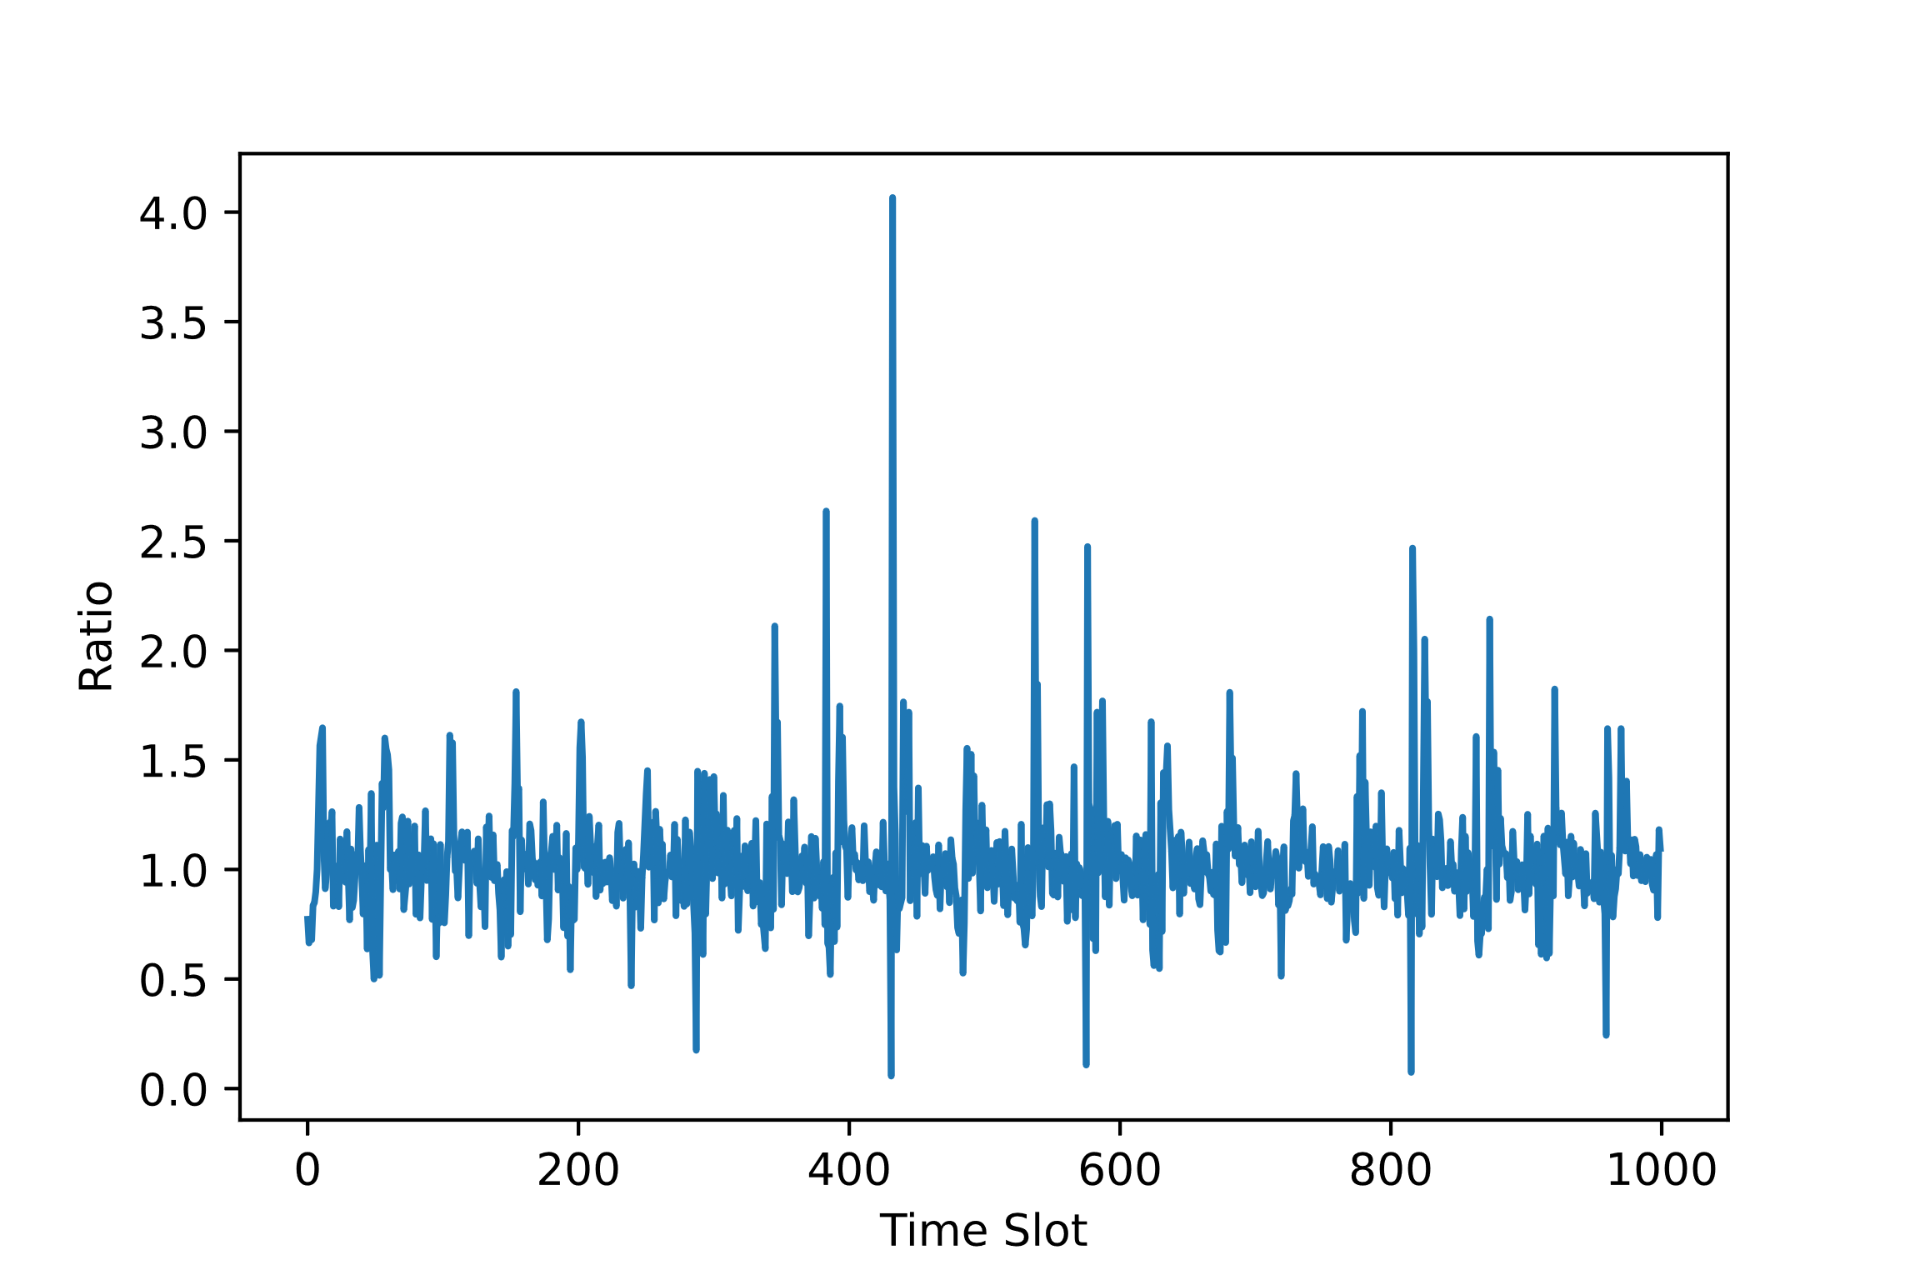

Problem Formation
Temporal dependencies. The flow of a region is affected by recent time intervals, both near and far.
Closeness
Ratio = $\frac{x_{t}}{x_{t−1}}$
t
The flow data is close to the recent intervals.
Notes:
Traffic flow data are generally smooth with few abrupt changes and they are similar to each other within adjacent frames. As shown in the figure in the right, the ratio of current traffic flow to the previous one floats up and down within a fixed ratio of 1. meaning that The flow data is close to the recent intervals.

Slide 12
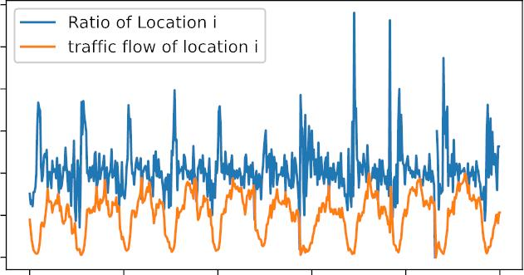
Problem Formation
Given historical data, traffic flow prediction aims to predict the traffic flow in the future.
Temporal dependencies. The flow of a region is affected by recent time intervals, both near and far.
Periodicity
t
Time Slot
The flow data is relevant to the remote intervals.
Notes:
The other part is periodicity. As shown in the orange line in the figure, the traffic flow periodically goes up and down.

Slide 13
Accurate traffic prediction requires learning…
Short and long-range spatial dependencies.
Temporal closeness & periodicity.
Notes:
To summarize, Accurate traffic prediction requires learning… short and Long-range spatial dependencies. Temporal closeness & periodicity.

Slide 14
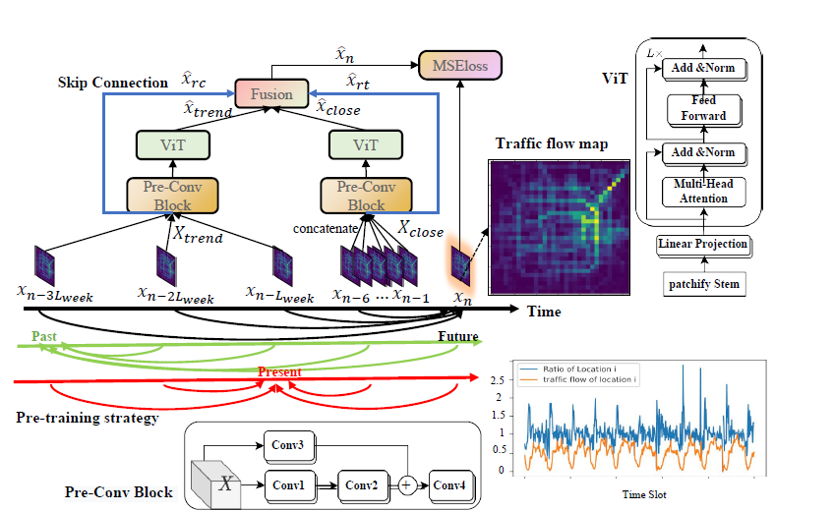
Spatial-temporal Transformer Network with Self-supervised Learning (ST-TSNet)
Notes:
TO this end, we propose the Spatial-temporal Transformer Network with Self-supervised Learning (ST-TSNet)

Slide 15
Spatial-temporal Transformer Network with Self-supervised Learning (ST-TSNet)
Input
Notes:
We split the historical data into two components,, the closeness components, and trend components, which are sampled by specific time intervals.

Slide 16
Spatial-temporal Transformer Network with Self-supervised Learning (ST-TSNet)
Pre-Conv Block
short-range dependencies.

Slide 17
Spatial-temporal Transformer Network with Self-supervised Learning (ST-TSNet)
ViT
Long-range dependencies.
Notes:
ST-TSNet consists of a Pre-Conv Block and ViT for learning spatial correlations in both local and global contexts.

Slide 18
Spatial-temporal Transformer Network with Self-supervised Learning (ST-TSNet)
Skip connection
Temporal closeness.
Notes:
we directly connect the historical data to the output to use the historical data as the base predictions, since the future traffic volumes are similar to recent intervals. Such motivation provides a prior knowledge that forces the model to predict the future data partially based on the original historical records instead of completely depending on the extracted temporal patterns.

Slide 19
Spatial-temporal Transformer Network with Self-supervised Learning (ST-TSNet)
Pre-Conv Block
ViT
Skip connection
Notes:
To summarize, We propose the Pre-Conv Block and ViT for learning spatial correlations in both local and global contexts and a skip connection strategy to learn temporal closeness.
Let’s talk about another idea in this work.

Slide 20
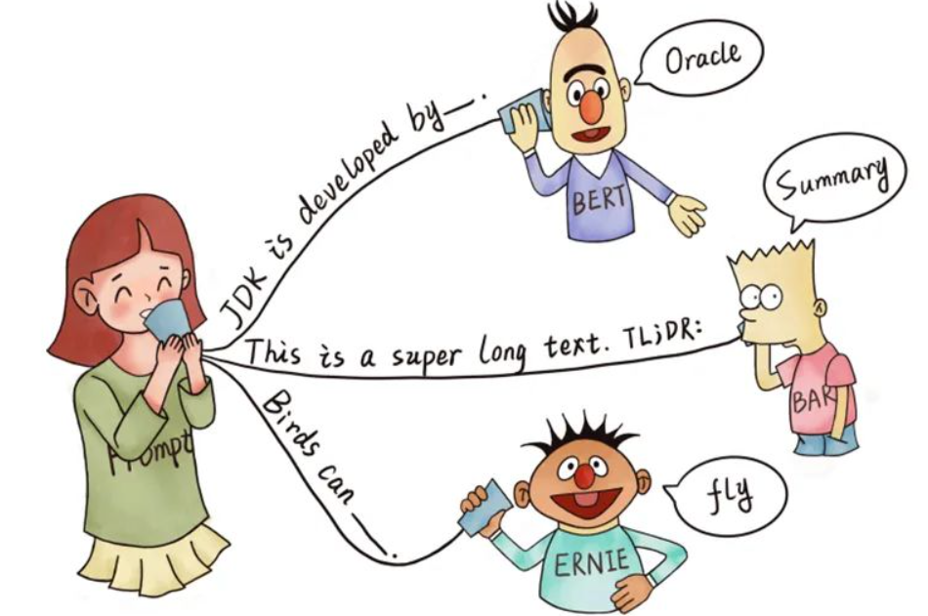
Self-supervised learning
Notes:
self-supervised learning [Devlin et al., 2019] have shown to be effective in various tasks for example, language understanding, where a pretext task is constructed to learn language representations and then transferred to facilitate downstream tasks.

Slide 21






Self-supervised learning in traffic flow prediction task
Recap: Traffic flow prediction task
t
$$x_{1}$$
$$x_{2}$$
$$x_{3}$$
$$x_{4}$$
$$x_{5}$$
$$x_{6}$$
Notes:
While in the field of traffic flow prediction, current training algorithms are supervised learning, where the historical records are regarded as input and the traffic data in the next timestamp is served as label. No effective pretraining task is proposed.

Slide 22
Self-supervised learning in traffic flow prediction task
A pretraining strategy called Stochastic argumentation
Traffic flow prediction task
Exchange
t
$$x_{1}$$
$$x_{2}$$
$$x_{3}$$
$$x_{4}$$
$$x_{5}$$
$$x_{6}$$

Slide 23






Stochastic argumentation
Traffic flow prediction task
Pretraining task
t
$$x_{1}$$
$$x_{2}$$
$$x_{3}$$
$$x_{4}$$
$$x_{5}$$
$$x_{6}$$
$$x_{1}$$
$$x_{6}$$
$$x_{3}$$
$$x_{4}$$
$$x_{5}$$
$$x_{2}$$
Input
target

Slide 24
Self-supervised learning in traffic flow prediction task
Randomly select a historical frame as the predicted target
Learn temporal dependencies.
Pretrained with stochastic augmentation.
Finetuned on traffic prediction task.
Pretraining task
$$x_{1}$$
$$x_{6}$$
$$x_{3}$$
$$x_{4}$$
$$x_{5}$$
$$x_{2}$$
Input
target

Slide 25
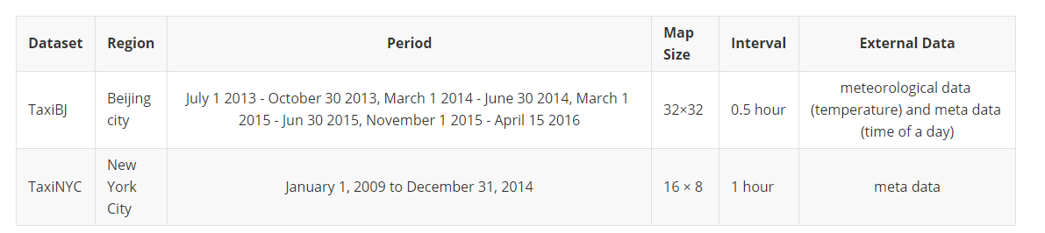
Experiments
Datasets

Slide 26
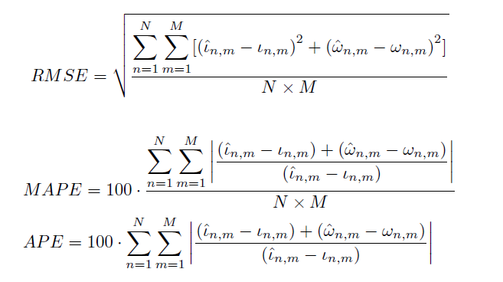
Experiments
Evaluation Metrics

Slide 27
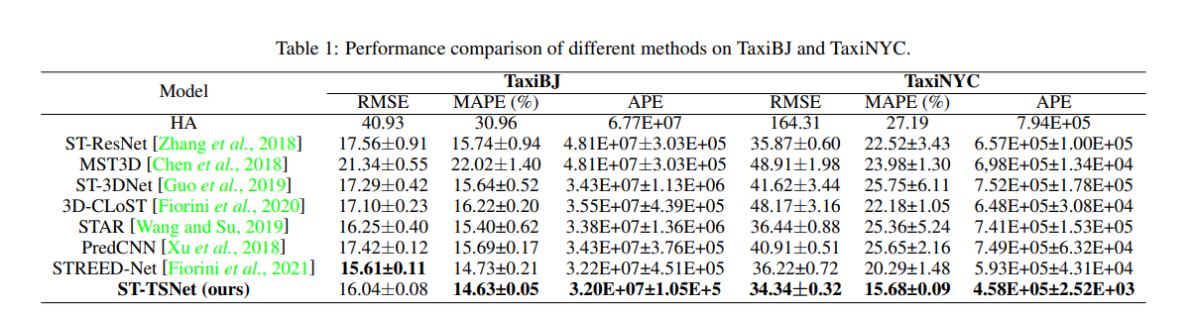
Experiments
Comparing with 7 Baselines
Outperform baselines on 5 out of 6 metrics.

Slide 28
Experiments
Comparing with Baselines
1.53 RMSE ↓
6.84 MAPE ↓
1.99E+05 APE ↓
Performance improvement is more significant in TaxiNYC dataset.

Slide 29
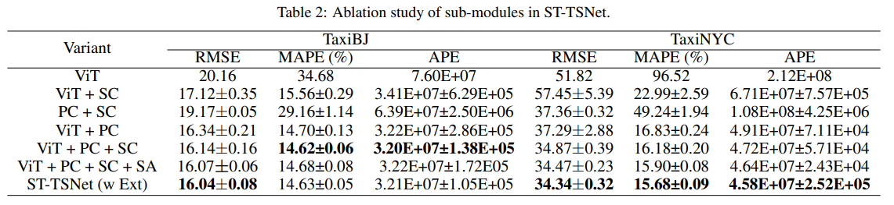
Experiments
Ablation
ViT: Vision Transformer
SC: Skip Connection
PC: Pre-Conv Block
SA: Stochastic Augmentation
Ext: External Data

Slide 30
Experiments
Ablation
ViT: Vision Transformer
SC: Skip Connection
PC: Pre-Conv Block
SA: Stochastic Augmentation
Ext: External Data
ViT vs. ViT + PC

Slide 31
Experiments
Ablation
ViT: Vision Transformer
SC: Skip Connection
PC: Pre-Conv Block
SA: Stochastic Augmentation
Ext: External Data
ViT + PC vs. ViT + PC + SC

Slide 32
Experiments
Ablation
ViT: Vision Transformer
SC: Skip Connection
PC: Pre-Conv Block
SA: Stochastic Augmentation
Ext: External Data
ViT + PC + SC vs. ViT + PC + SC + SA

Slide 33
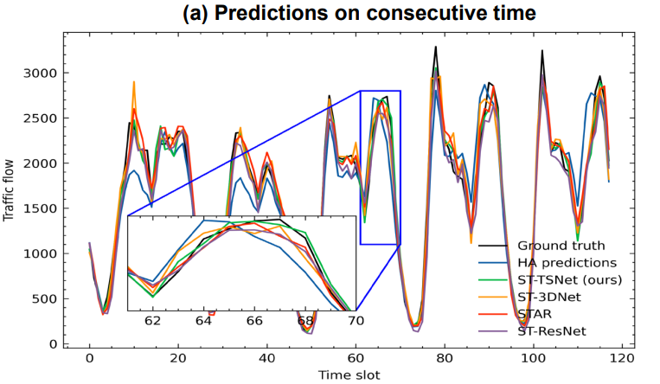
Experiments
Qualitative Analysis

Slide 34
Experiments
Qualitative Analysis
Our predictions fit the ground truth well.

Slide 35
Experiments
Qualitative Analysis
Our predictions fit the ground truth well.
The predictions of the baseline methods are similar, but deviate from the ground truth.

Slide 36
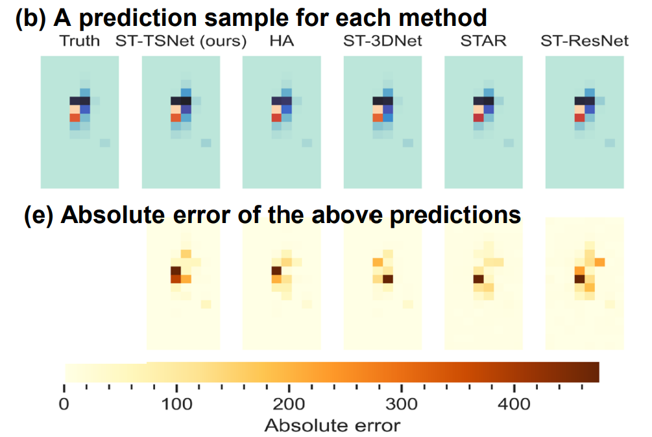
Experiments
Qualitative Analysis
(b) The flow map prediction of different methods.
(e) The absolute error of the predictions.
Lighter color -> lower error.

Slide 37
Experiments
Qualitative Analysis
Our method presents a lower error in these regions.
Lighter color -> lower error.

Slide 38
Experiments
Qualitative Analysis
Our method presents a lower error in these regions.
Lighter color -> lower error.

Slide 39
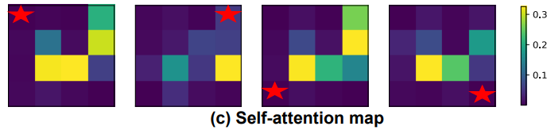
Experiments
Qualitative Analysis
Attention map of the four corner patches (the pentagram-marked).
Brighter color -> higher attention score.
Our method can attend to distant regions for learning long-range spatial correlations.

Slide 40
Acknowledgment
This research was funded by the National Natural Science Foundation of China and the Natural Science Foundation of Jiangxi Province.
Many Thanks to my parents for their love and support.

Slide 41
The end.

Slide 42
Questions?

